Slide 1
From Logistic Regression to the Multilayer Perceptron May 29, 2020
Lecture 1, Applied Data Science
MMCi Term 4, 2020
Matthew Engelhard
Notes:
Preliminaries – Intro
Plan for the weekend (lecture structure, computational assignment)
We’ll cover the quiz during the discussion section
Any questions about the course to start?

Slide 2
Overview of Applied Data Science Course
We will focus on current data science methods and their applications
What are data science, machine learning, and artificial intelligence; and how do they differ from statistics?
How do these techniques work, and what kinds of problems can they solve?
How can we develop our own data science models or projects?
Study algorithms that learn from data to make predictions or decisions
Notes:
Note that we’re focused on collaboration, etc.
Also note that we are going to jump right in and talk about models
Then we will pull back a little

Slide 3
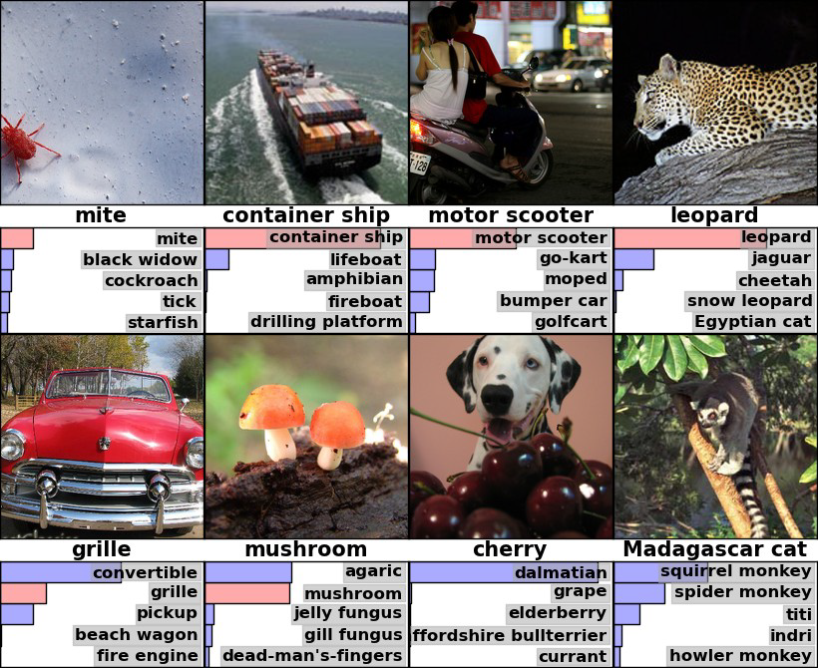
Neural networks are state-of-the-art for many applications
They are not new—many of the techniques go back decades
Recent resurgence due to amazing performance on benchmark tasks
One key task was the ImageNet Challenge
Want to recognize what is in an image (1 of 1000 categories)
Have ~1 million example images
Very relevant for things such as image search
Example images are shown on the right, with predicted categories beneath each image
Figure from Krizhevsky et al 2012
Notes:
Why are we learning about this? Well, machine learning is starting to disrupt clinical medicine
Neural networks are the predominant approach because right now they work best
They’ve been around for a while – at least the 70s – but only recently have they outshined other approaches.
-- we figured out the right architectures. We started using LOTS of data.
Describe ImageNet challenge – 2012 was the big turning point for neural networks. You might remember that before that, it was all about the support vector machine.
And the figure
Deep learning – a rebranding of neural networks
Machine learning goes beyond neural network approaches, but currently they are dominant

Slide 4
Machine Learning can surpass human performance
Top Performing ImageNet Algorithm By Year
For ImageNet:
Deep Learning was a huge jump forward
State-of-the-art systems significantly outperform humans on the same task
These use “Convolutional Neural Networks,” which you will learn about in block 2
Notes:
Describe ”top-5 error”

Slide 5
Machine Learning beats human performance in many tasks
Famously, Google DeepMind trained “AlphaGo” to beat the world champion Go player (a complex game)
AlphaGo uses Deep Reinforcement Learning (learned by repeatedly playing the game), to be covered in block 4
Many other examples:
Voice Recognition
Object Detection
Text Translation
Etc.

Slide 6
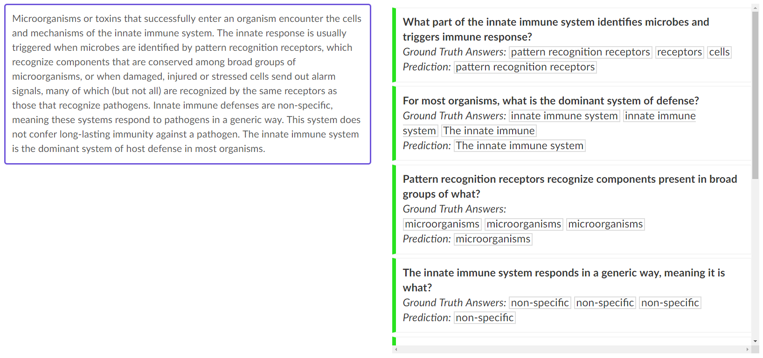
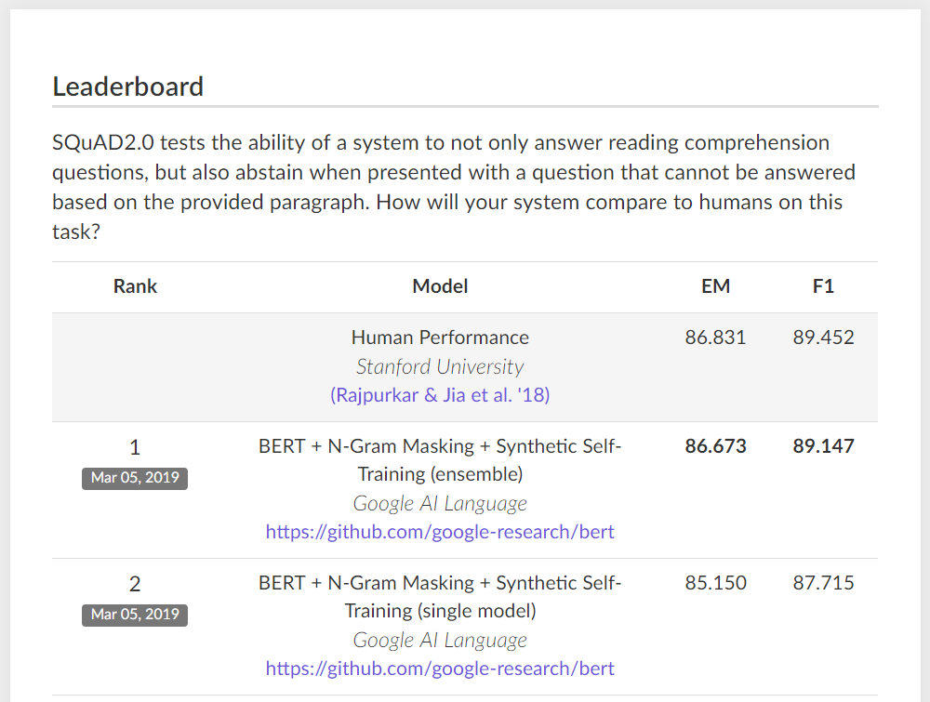
Deep Learning is Approaching Human Performance in Language Understanding Tasks
Notes:
SQuAD 2.0 developed in 2016
Paragraphs of content along with questions about that content
Here we have paragraph about the immune system along with relevant questions that can be answered. But again, not all of these questions can be answered, and it is important for the system to recognize this.
Exact match. This metric measures the percentage of predictions that match any one of the ground truth answers exactly.
(Macro-averaged) F1 score. This metric measures the average overlap between the prediction and ground truth answer. We treat the prediction and ground truth as bags of tokens, and compute their F1. We take the maximum F1 over all of the ground truth answers for a given question, and then average over all of the questions

Slide 7
SYSTEM PROMPT (HUMAN-WRITTEN)
A train carriage containing controlled nuclear materials was stolen in Cincinnati today. Its whereabouts are unknown.
MODEL COMPLETION (MACHINE-WRITTEN, FIRST TRY)
The incident occurred on the downtown train line, which runs from Covington and Ashland stations.
In an email to Ohio news outlets, the U.S. Department of Energy said it is working with the Federal Railroad Administration to find the thief.
“The theft of this nuclear material will have significant negative consequences on public and environmental health, our workforce and the economy of our nation,” said Tom Hicks, the U.S. Energy Secretary, in a statement. “Our top priority is to secure the theft and ensure it doesn’t happen again.”
The stolen material was taken from the University of Cincinnati’s Research Triangle Park nuclear research site, according to a news release from Department officials.
The Nuclear Regulatory Commission did not immediately release any information.
According to the release, the U.S. Department of Energy’s Office of Nuclear Material Safety and Security is leading that team’s investigation.
“The safety of people, the environment and the nation’s nuclear stockpile is our highest priority,” Hicks said. “We will get to the bottom of this and make no excuses.
“Better Language Models and Their Implications”
2/14/19
OpenAI
Notes:
Generative models based on transformer architecture and trained on 8 million webpages

Slide 8
Data Science in Medicine
Notes:
How does all this affect medicine?
There are five parts to this course. We’ll be talking about the basics of neural networks; CNNs; natural language processing; time-series modeling; and reinforcement learning.
The basic NN course – this is the foundation for everything else. Sometimes using nonlinear models makes a big impact, sometimes not. But have to understand this to understand the subsequent areas, for which nonlinear models are critical.
Imaging is already there – we’re getting ML-based diagnostics – plain images, dermoscopy, ultrasound, fundoscopic images, radiology, pathology, etc.
NLP is right on the cusp – so far the ‘NLP’ that’s out there hasn’t been very smart – very context aware – but NLP systems are right at human-performance, and it’s going to start making a huge impact very soon. Can only hope that NLP starts reducing some of the documentation burden placed on physicians.
RL is also very close, though evaluation here is more difficult.

Slide 9
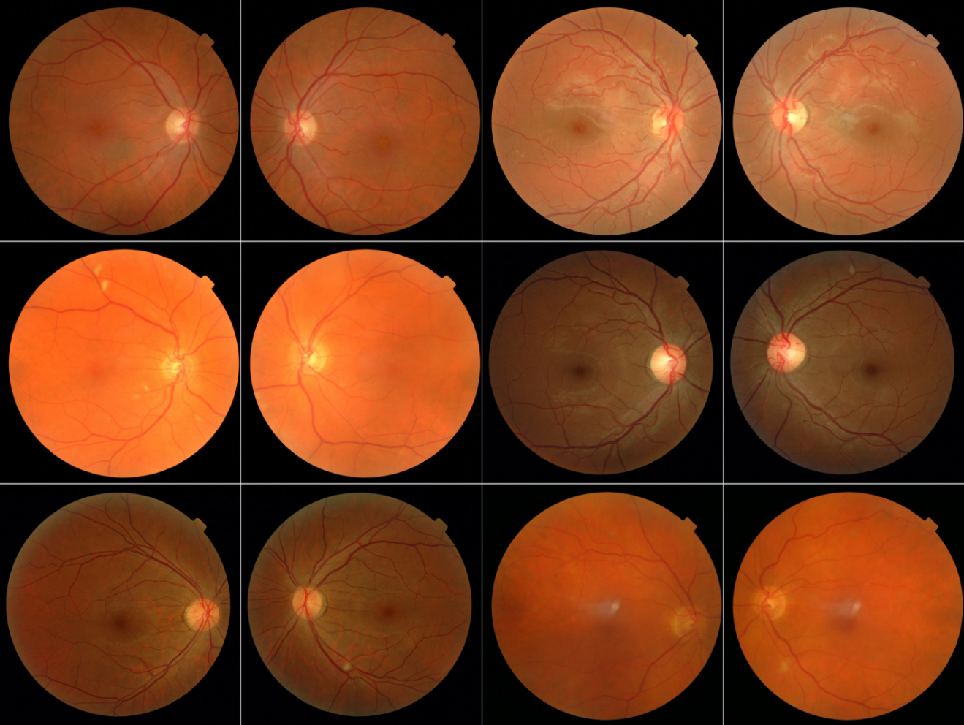
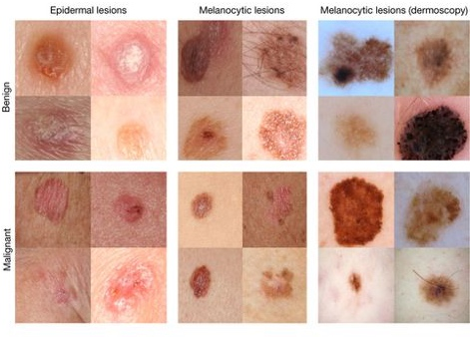
Deep learning-based diagnostics for medical images exceed expert performance
Improved Automated Detection of Diabetic Retinopathy
Invest. Ophthalmol. Vis. Sci.. 2016;57(13):5200-5206. doi:10.1167/iovs.16-19964
Dermatologist-level classification of skin cancer
Nature volume 542, pages 115–118 (02 February 2017)
Notes:
How does all this affect medicine?
There are five parts to this course. We’ll be talking about the basics of neural networks; CNNs; natural language processing; time-series modeling; and reinforcement learning.
Imaging is already there – we’re getting ML-based diagnostics – plain images, dermoscopy, ultrasound, fundoscopic images, radiology, pathology, etc.
NLP is right on the cusp – so far the ‘NLP’ that’s out there hasn’t been very smart – very context aware – but NLP systems are right at human-performance, and it’s going to start making a huge impact very soon. Can only hope that NLP starts reducing some of the documentation burden placed on physicians.
RL is also very close, though evaluation here is more difficult.

Slide 10
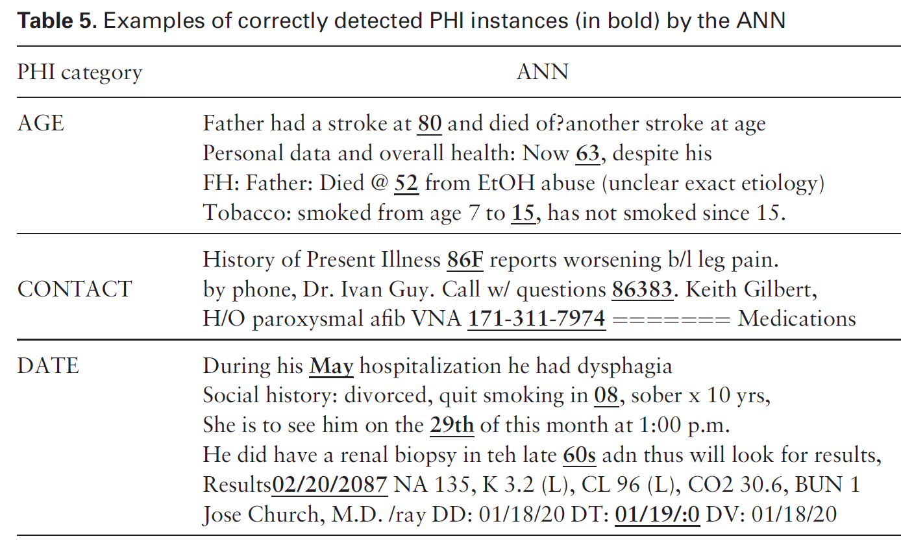
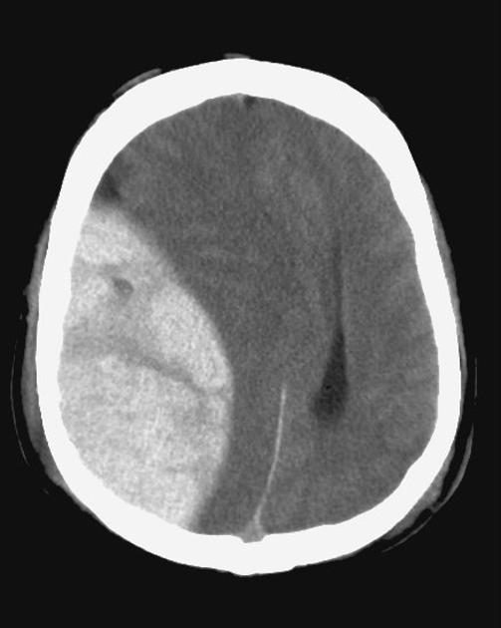
Natural language processing models are beginning to make an impact
Classification of radiology reports using neural attention models, IJCNN 2017
De-identification of patient notes with recurrent neural networks
JAMIA 24(3), 2017, 596–606
Mass effect from extradural hemorrhage
https://radiopaedia.org
Notes:
How does all this affect medicine?
There are five parts to this course. We’ll be talking about the basics of neural networks; CNNs; natural language processing; time-series modeling; and reinforcement learning.
Imaging is already there – we’re getting ML-based diagnostics – plain images, dermoscopy, ultrasound, fundoscopic images, radiology, pathology, etc.
NLP is right on the cusp – so far the ‘NLP’ that’s out there hasn’t been very smart – very context aware – but NLP systems are right at human-performance, and it’s going to start making a huge impact very soon. Can only hope that NLP starts reducing some of the documentation burden placed on physicians.
RL is also very close, though evaluation here is more difficult.

Slide 11
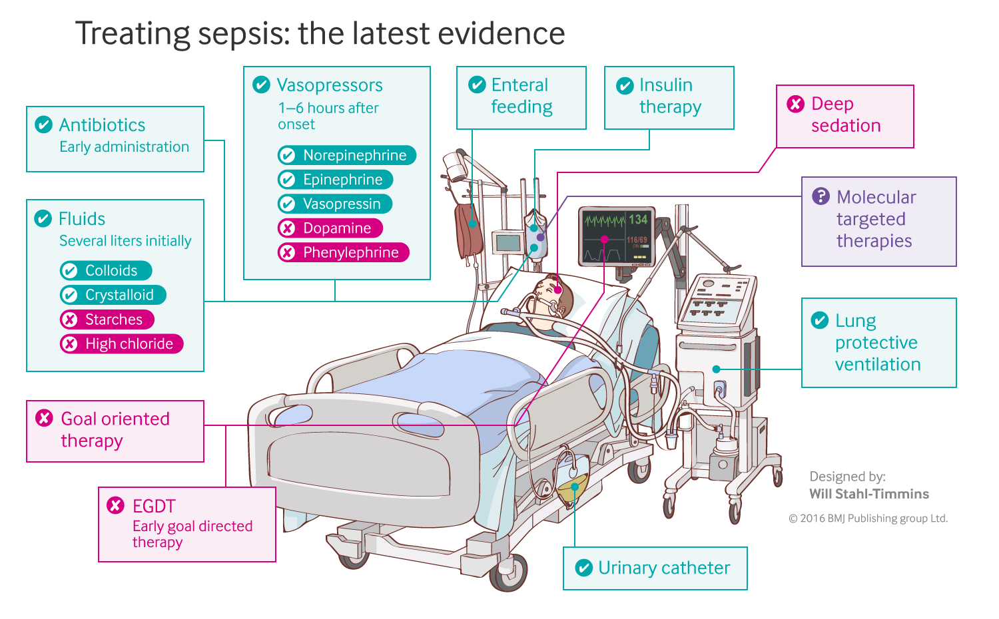
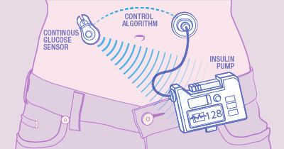
Sequential decision-making algorithms can also exceed human performance
Closed-loop blood glucose control
(“artificial pancreas”)
Fluid and vasopressor administration
for sepsis treatment
https://www.mayo.edu/research/labs/artificial-pancreas/overview
Gotts JE, Matthay MA. Sepsis: pathophysiology and clinical management. bmj. 2016 May 23;353(i1585).
Notes:
How does all this affect medicine?
There are five parts to this course. We’ll be talking about the basics of neural networks; CNNs; natural language processing; time-series modeling; and reinforcement learning.
Imaging is already there – we’re getting ML-based diagnostics – plain images, dermoscopy, ultrasound, fundoscopic images, radiology, pathology, etc.
NLP is right on the cusp – so far the ‘NLP’ that’s out there hasn’t been very smart – very context aware – but NLP systems are right at human-performance, and it’s going to start making a huge impact very soon. Can only hope that NLP starts reducing some of the documentation burden placed on physicians.
RL is also very close, though evaluation here is more difficult.

Slide 12
a “Shallow” Network: Logistic Regression
Begin with a simple model, then add complexity

Slide 13
First: What is a Predictive Model?
y, associated value or label
x, data/features for a subject or patient
End goal: predict y from x
Notes:
Suppose we have a vector of measurements (x)
Associated with those measurements is an outcome – or a label – or another measurement (y)
We’d like to make a prediction about (y) that is based on (x)
Maybe (y) is a home price. X is a bunch of information about that home, e.g. square footage, number of bedrooms, how old, neighborhood, school district. Let’s say we’d like to make an informed guess about the home price based on all that information. What we need is a predictive model.

Slide 14
ICU Mortality: APACHE III
WBC Count
Respiratory Rate
Creatinine
Mean BP
Hematocrit
Age
Temperature
Pulse Rate
Survival
End goal: predict odds of hospital mortality
Notes:
ACUTE PHYSIOLOGY AND CHRONIC HEALTH EVALUATION
Predictive models are nothing new in medicine – APACHE, for instance – this is to predict mortality in ICU setting – has been around since the 70s.
In an ICU setting, we might want a model that takes a bunch of measurements about a patient -- their age (demographics), vitals, lab values, and some information about chronic health conditions and predicts their risk of dying (or likelihood of surviving…)

Slide 15
Learning a Predictive Model from Labeled Data
y, associated value or label
x, data/features for a subject or patient
The learning process: find the equation that best predicts y based on x
Notes:
So how do we make these predictions?
Well, first we need a model.
A model is a mathematical equation or program that x’s as input and returns a prediction about y as output.
And the equation has two parts.
There’s the form of the equation – for example a line, a polynomial, etc – and the specific instantiation of that equation or program
The model has parameters – for example, the slope of the line
And we want to figure out which parameters are best matched to our data.
This is called “training” the model.
Ultimately we want to predict y without learning it. But first we need a dataset – this is pairs of x and y – so we can learn the relationship between the two and encode it in our model parameters

Slide 16
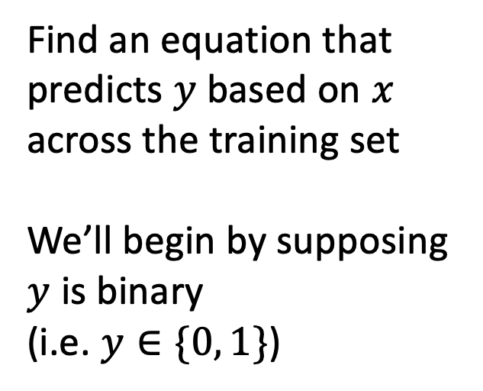
Training Set (Historical Data)
x₁
y₁
Find an equation that predicts $y$ based on $x$ across the training set
We’ll begin by supposing $y$ is binary
(i.e. $y∈\{0, 1\}$)
x₂
y₂
x₃
y₃
x₄
y₄
…
…
x_{N-1}
y_{N-1}
x_{N}
y_{N}
Notes:
How do we do that?
Gather a bunch of historical data
Want to find an equation that predicts y well based on x across that historical data
Y could be a numeric value, or a rank – but today, we’re going to assume that y is binary.
We model (y) as a Bernoulli random variable – this just means that it’s an event that may or may not occur, with some probability – and we suppose that probability is a function of x
So we take all this data, we use it to find the parameters that are most consistent with the patterns of x and y that are present

Slide 17
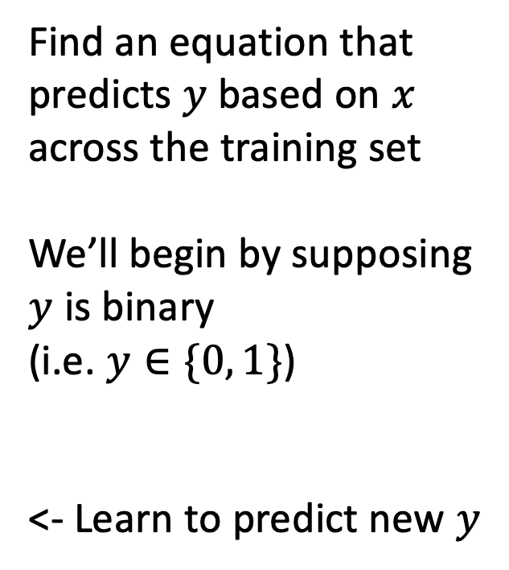

Making Predictions for New $x$
x₁
y₁
x₂
y₂
Find an equation that predicts $y$ based on $x$ across the training set
We’ll begin by supposing $y$ is binary
(i.e. $y∈\{0, 1\}$)
<- Learn to predict new $y$
x₃
y₃
x₄
y₄
…
…
x_{N-1}
y_{N-1}
x_{N}
y_{N}
x_{N+1}
y_{N+1}
Notes:
Having done that, we have a trained model. Our parameters are learned – we hold them fixed.
Now, when we see a NEW value of x, we simply plug it into our “learned” equation, and it tells us what we expect y to be. This is prediction.

Slide 18
Linear Predictive Model
z_{i}
b₁
b_{M}
$$zi=b_{1}x_{i1}+b_{2}x_{i2}+…+b_{M}x_{iM}$$
x_{i1}
x_{iM}
Notes:
- To start, we want the simplest model possible. Let’s start with a linear model. This means we can multiply our features by scalar values and add them together.
- Point out the notation here. We now have two indices – we have N values of x as a whole, but x itself has M components.
- Also point out our graph notation.
M features, M distinct parameters
But this isn’t quite right – we need to end up with a probability -- a value between zero and 1 -- whereas this is going to give us an unbounded numeric value.

Slide 19


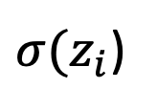
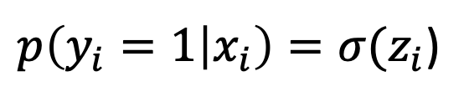
Convert to a Probability
$$zi=b_{1}x_{i1}+b_{2}x_{i2}+…+b_{M}x_{iM}+…+b_{0}$$
$p\left(y_{i}=1 | x_{i}\right)=σ(z_{i}$)
Extra Constant
(i.e. intercept)
(i.e. bias)
$σ(z_{i}$)
Notes:
So we use a link function – in this case, the sigmoid function, aka the logistic function, to convert the output of our linear model to a valid probability.
Inverse of the log link function is log(p / 1-p) – this is the log of the ratio between the probability the event will occur and the probability that it won’t. This allows us to interpret the output of our linear model as the “log-odds”.

Slide 20
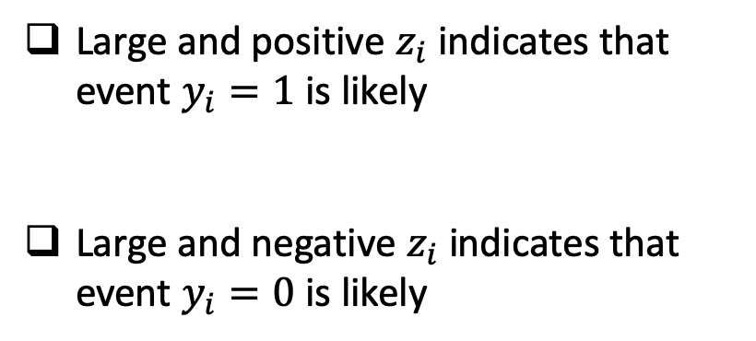
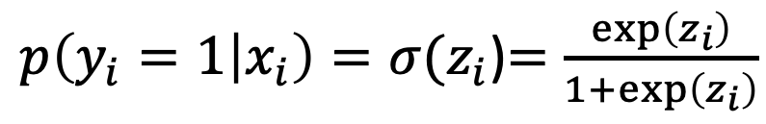
Convert to a Probability
$$zi=b_{1}x_{i1}+b_{2}x_{i2}+…+b_{M}x_{iM}+…+b_{0}$$
$p\left(y_{i}=1 | x_{i}\right)=σ(z_{i}$)$=\frac{\exp\left(z_{i}\right)}{1+\exp\left(z_{i}\right)}$
Large and positive $z_{i}$ indicates that event $y_{i}=1$ is likely
Large and negative $z_{i}$ indicates that event $y_{i}=0$ is likely
Notes:
Note that sigma is the logistic link function
Inverse of the log link function is log(p / 1-p) – this is the log of the ratio between the probability the event will occur and the probability that it won’t. This allows us to interpret the output of our linear model as the “log-odds”.

Slide 21
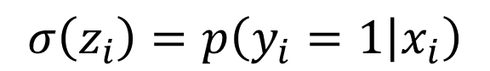

Logistic Regression
$$σ\left(z_{i}\right)=p\left(y_{i}=1 | x_{i}\right)$$
$$σ$$
z_{i}
b₁
b_{M}
$$p\left(y_{i}=1 | x_{i}\right)=σ(b_{1}x_{i1}+b_{2}x_{i2}+…+b_{M}x_{iM})$$
x_{i1}
x_{iM}
Notes:
By combining these two, we get logistic regression

Slide 22
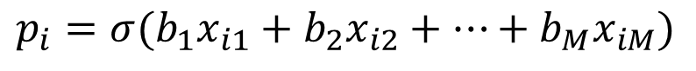
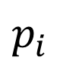
Logistic Regression
$$p_{i}$$
$$σ$$
z_{i}
b₁
b_{M}
$$p_{i}=σ(b_{1}x_{i1}+b_{2}x_{i2}+…+b_{M}x_{iM})$$
x_{i1}
x_{iM}

Slide 23
Logistic Regression
$$p_{i}$$
$$σ$$
Linear
Model
z_{i}
b₁
b_{M}
$$p_{i}=σ(b_{1}x_{i1}+b_{2}x_{i2}+…+b_{M}x_{iM})$$
x_{i1}
x_{iM}

Slide 24
Logistic Regression
Convert to a
Probability
$$p_{i}$$
$$σ$$
z_{i}
b₁
b_{M}
$$p_{i}=σ(b_{1}x_{i1}+b_{2}x_{i2}+…+b_{M}x_{iM})$$
x_{i1}
x_{iM}
Notes:
Before we go through an example – what questions do you have?

Slide 25
ICU Mortality Prediction
Illustrative Example

Slide 26
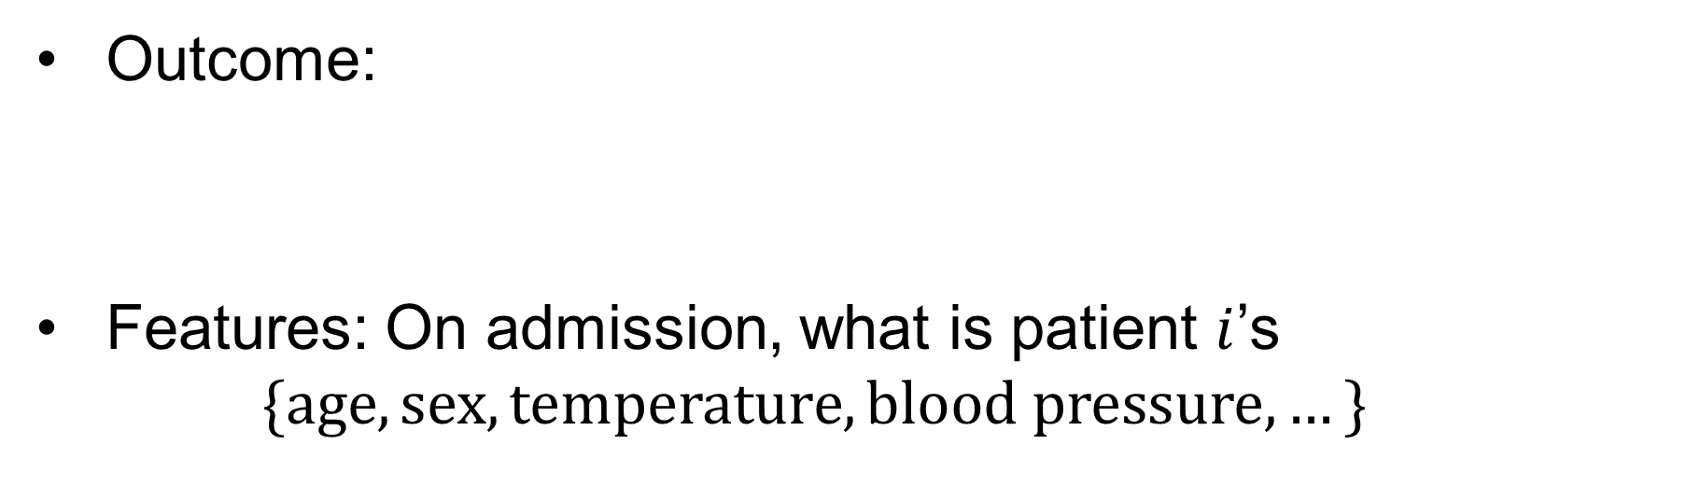
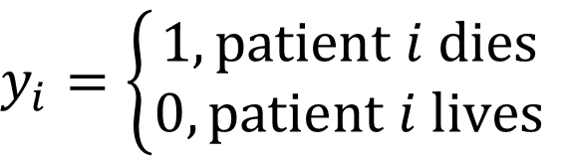
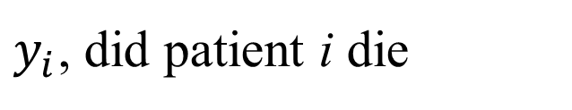
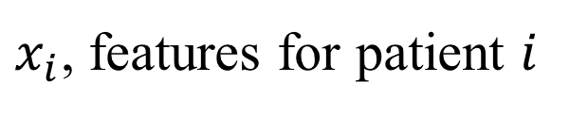
Example: ICU Mortality Prediction
Outcome:
Features: On admission, what is patient $i$’s
$$\{age, sex, temperature,blood pressure,…\}$$
$$y_{i}=\left\{\begin{aligned}1, patient i dies \\ 0, patient i lives\end{aligned}\right.$$
$y_{i}$, did patient i die
$x_{i}$, features for patient $i$

Slide 27
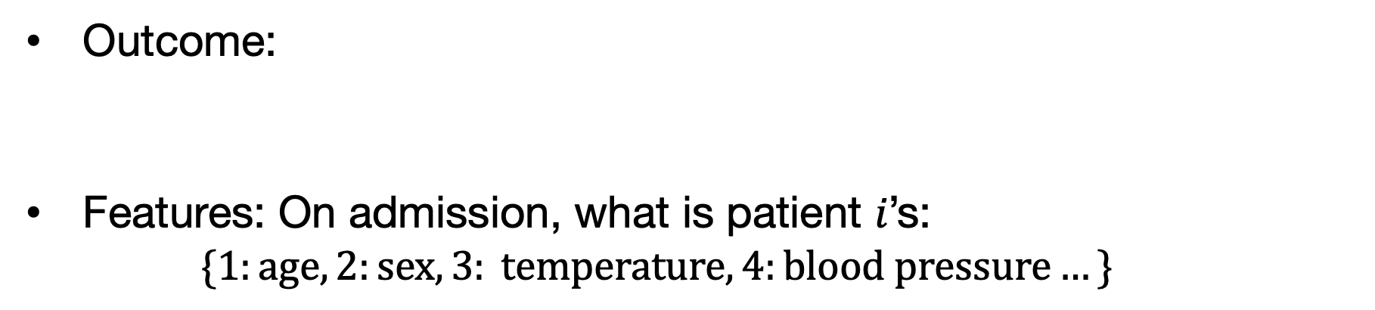
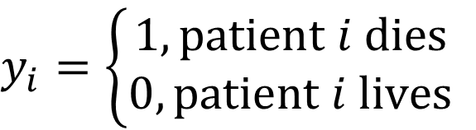
Example: ICU Mortality Prediction
Outcome:
Features: On admission, what is patient 𝑖’s:
$$\{1:age, 2:sex, 3: temperature, 4:blood pressure…\}$$
$$y_{i}=\left\{\begin{aligned}1, patient i dies \\ 0, patient i lives\end{aligned}\right.$$
$$zi=b_{1}x_{i1}+b_{2}x_{i2}+…+b_{M}x_{iM}+b_{0}$$
Age
Blood Pressure
If increased age increases odds of mortality, $b_{1}$ should be positive

Slide 28
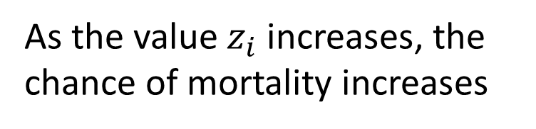
Impact on the Sigmoid Function
$$zi=b_{1}x_{i1}+b_{2}x_{i2}+…+b_{M}x_{iM}+b_{0}$$
$p\left(y_{i}=1 | x_{i}\right)=σ(z_{i}$)
Age
Chance of Rain
As the value $z_{i}$ increases, the chance of mortality increases
Notes:
“squashes” values between zero and 1… cannot have probability outside of this range

Slide 29
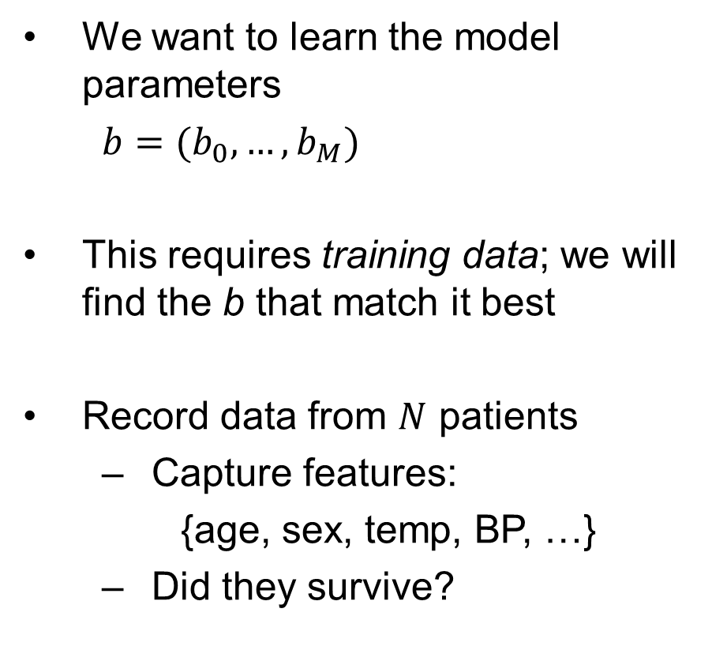
Building the Training Set
We want to learn the model parameters
$b=(b_{0},…,b_{M})$
This requires training data; we will find the b that match it best
Record data from $N$ patients
Capture features:
{age, sex, temp, BP, …}
Did they survive?
x₁
y₁
x₂
y₂
x₃
y₃
x₄
y₄
…
…
x_{N-1}
y_{N-1}
x_{N}
y_{N}

Slide 30
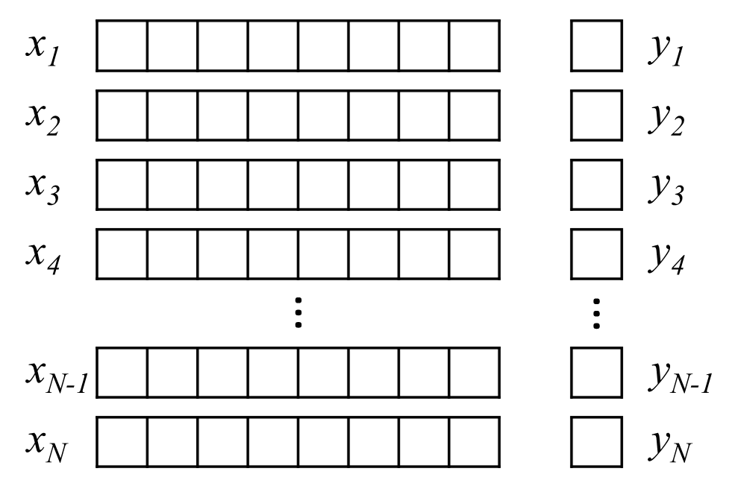
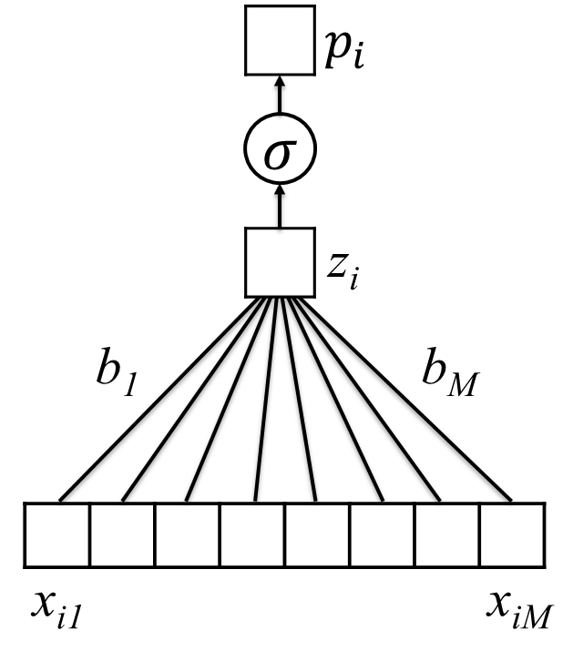
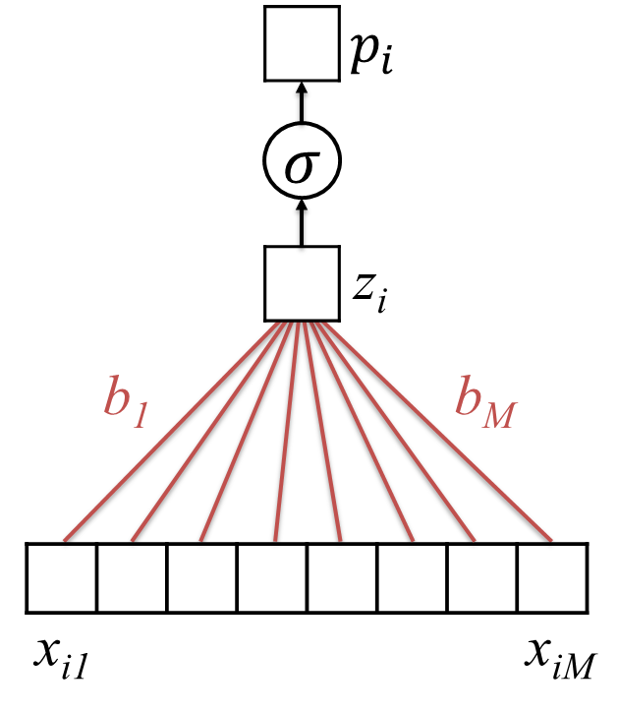
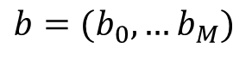
Learning Model Parameters
Training Set
$$p_{i}=σ(b_{0}+b_{1}x_{i1}+b_{2}x_{i2}+…+b_{M}x_{iM})$$
$b=(b_{0},…b_{M})$
Untrained Logistic Regression
Model (or “Network”)
Trained Model (with learned parameters)

Slide 31

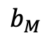

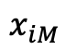
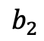


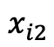
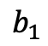
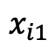

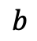
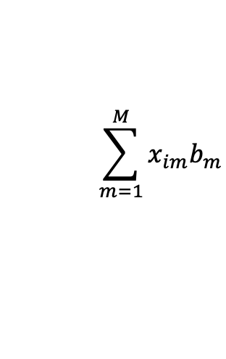
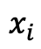


Simplifying our Notation…
$$zi=b_{1}x_{i1}+b_{2}x_{i2}+…+b_{M}x_{iM}$$
$$x_{i1}$$
$$x_{i2}$$
$$…$$
$$…$$
$$x_{iM}$$
$$x_{i}$$
$$\sum_{m=1}^{M}{x_{im}b_{m}}$$
$$×$$
$$×$$
$$…$$
$$…$$
$$×$$
$$b$$
$$b_{1}$$
$$b_{2}$$
$$…$$
$$…$$
$$b_{M}$$

Slide 32
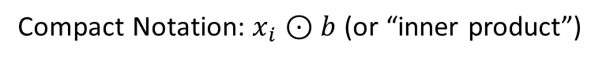
Simplifying our Notation…
$$zi=b_{1}x_{i1}+b_{2}x_{i2}+…+b_{M}x_{iM}$$
$$x_{i1}$$
$$x_{i2}$$
$$…$$
$$…$$
$$x_{iM}$$
$$x_{i}$$
$$\sum_{m=1}^{M}{x_{im}b_{m}}$$
$$×$$
$$×$$
$$…$$
$$…$$
$$×$$
$$b$$
$$b_{1}$$
$$b_{2}$$
$$…$$
$$…$$
$$b_{M}$$
Compact Notation: $x_{i}⊙b$ (or “inner product”)

Slide 33

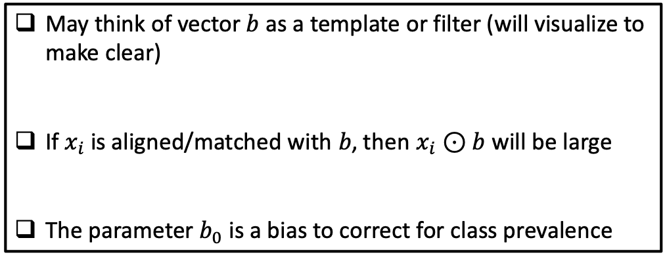
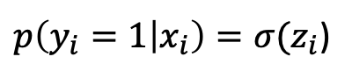
Interpretation of Logistic Regression
$$z_{i}=b_{0}+b_{1}x_{i1}+b_{2}x_{i2}+b_{M}x_{iM}$$
$=b_{0}+x_{i}⊙b$
$p\left(y_{i}=1 | x_{i}\right)=σ(z_{i}$)
May think of vector $b$ as a template or filter (will visualize to make clear)
If $x_{i}$ is aligned/matched with $b$, then $x_{i}⊙b$ will be large
The parameter $b_{0}$ is a bias to correct for class prevalence

Slide 34
Recognizing Handwritten Digits
A visual example:

Slide 35
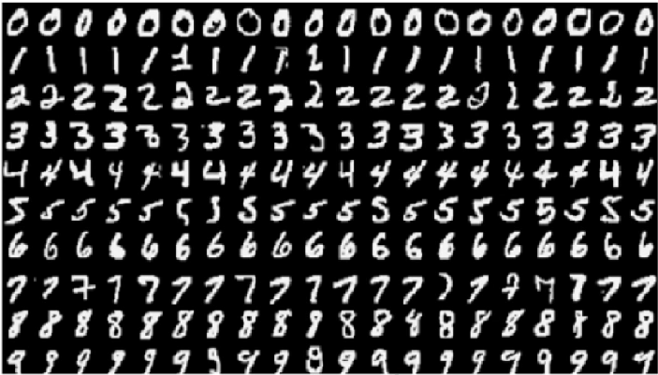
The MNIST Dataset
The Modified National Institute of Standards and Technology (MNIST) contains pictures of handwritten digits (0,1,2,…)
Want to be able to tell what digit each image is (e.g., optical character recognition)

Slide 36
Images are Encoded as Numbers

Slide 37
Vectorization
We will start talking about deep learning without using the structure of the image
Later, in block 2, we will consider how to take advantage of this structure
To convert an image into an unstructured set of numbers, we vectorize (or flatten) it
vectorization

Slide 38
Start With The Binary Case
Zeros
Ones

Slide 39
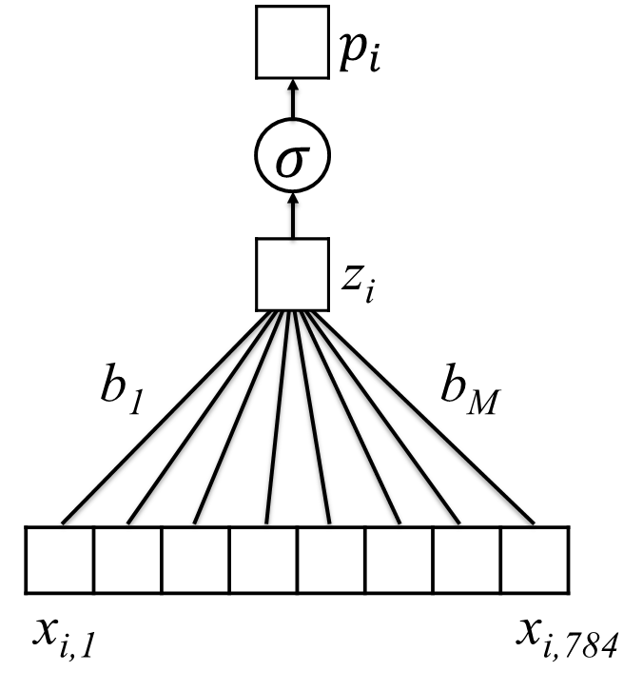
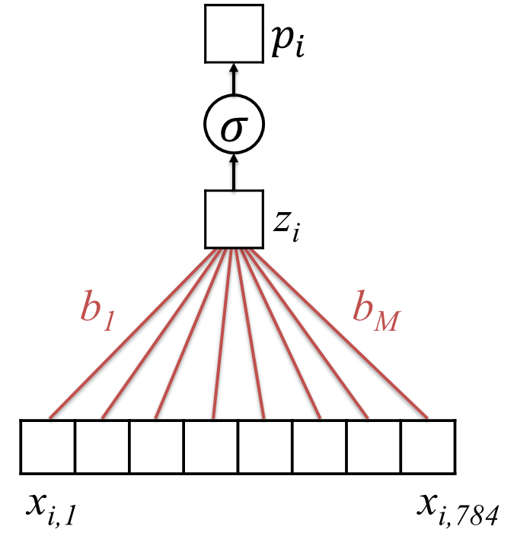
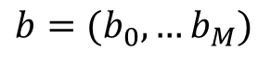
Learning on MNIST
Vectorize
Training set:
28 x 28 images
$$p_{i}=σ(b_{0}+b_{1}x_{i1}+b_{2}x_{i2}+…+b_{M}x_{iM})$$
$b=(b_{0},…b_{M})$
Untrained Logistic Regression
Model (or “Network”)
Trained Model (with learned parameters)

Slide 40

Zooming in on 0/1
$$σ\left( \right)$$
$$⊙$$

Slide 41

Zooming in on 0/1
Negative Sections
$$σ\left( \right)=0.006$$

Slide 42

Zooming in on 0/1
Positive Section
$$σ\left( \right)=.991$$

Slide 43

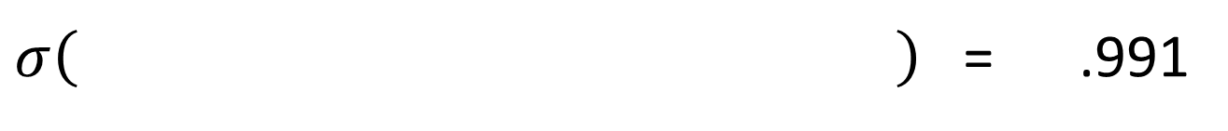
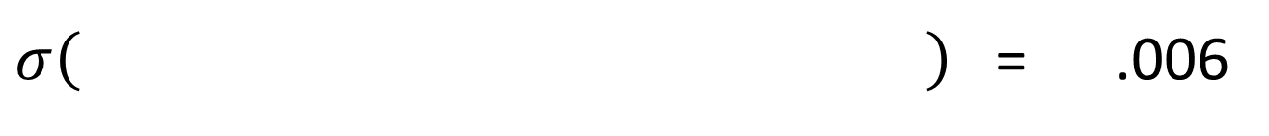

Learned Weights for 0/1
We think that this is a “zero” (.6% chance it is a “one”)
$σ\left( \right)$ = .006
$$⊙$$
We think that this is a “one” (99.1% chance it is a “one”)
$σ\left( \right)$ = .991
$$⊙$$

Slide 44
Generalizing Logistic Regression
From Shallow to Deep Learning

Slide 45
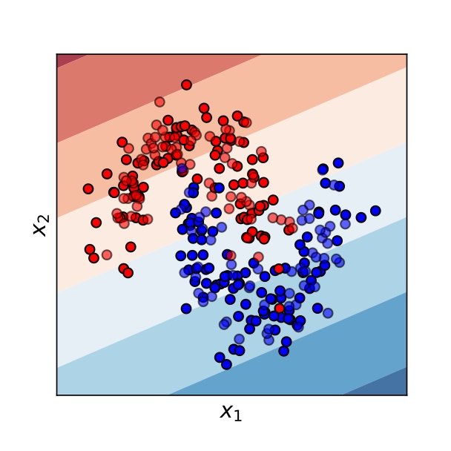
Logistic Regression is a “Linear” Classifier
A “generalized linear model”
Can only split data by linear trends

Slide 46
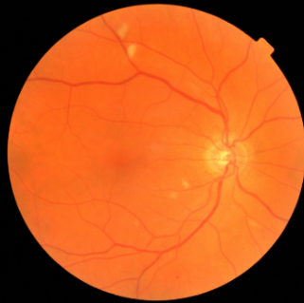
Spatial, Temporal, and/or Semantic Structure
Notes:
Different from the independent-ish predictors we’ve been using before

Slide 47
What Do Individual Pixels Tell Us about y?
y, associated value or label
x, data/features for a subject or patient
End goal: predict y from x
Notes:
How does a single pixel make it a dog or not a dog?
Now imagine you don’t even know how to spot it yourself (e.g. in medical images)

Slide 48

We need more flexible, non-linear classifiers
Many ways to achieve this…
One of them is to “extend” logistic regression to form a multilayer perceptron, i.e. a neural network

Slide 49
How can we modify logistic regression to learn complex, nonlinear relationships?
$$p_{i}$$
$$σ$$
z_{i}
b₁
b_{M}
x_{i1}
x_{iM}

Slide 50

How can we modify logistic regression to learn complex, nonlinear relationships?
$$p_{i}=σ(b_{0}+b⊙x)$$
b₁
b_{M}
x_{i1}
x_{iM}

Slide 51


Instead of predicting $p_{i}$ directly from our feature vector $x$, introduce a vector of “latent” features $ζ$ (zeta) that we will use to predict $p_{i}$
$$p_{i}=σ(b_{0}+b⊙\text{ζ})$$
b₁
b_{M}
ζ_{i1}
ζ_{iM}

Slide 52



Instead of predicting $p_{i}$ directly from our feature vector $x$, introduce a vector of “latent” features $ζ$ (zeta) that we will use to predict $p_{i}$
$$p_{i}=σ(b_{0}+b⊙\text{ζ})$$
b₁
b_{M}
ζ_{i1}
$$\text{ζ}\text{iM}=σ(β_{M0}+β_{M}⊙x)$$
Individual elements of 𝜁 will themselves be the output of a logistic-regression-like model based on 𝑥
x_{i1}
x_{iM}

Slide 53

Instead of predicting $p_{i}$ directly from our feature vector $x$, introduce a vector of “latent” features $ζ$ (zeta) that we will use to predict $p_{i}$
$$p_{i}=σ(b_{0}+b⊙\text{ζ})$$
b₁
b_{M}
ζ_{i1}
$$\text{ζ}\text{iM}$$
Individual elements of 𝜁 will themselves be the output of a logistic-regression-like model based on 𝑥
x_{i1}
x_{iM}
Since this is true for all elements of 𝜁, x and 𝜁 are said to be “fully connected”

Slide 54
Instead of predicting $p_{i}$ directly from our feature vector $x$, introduce a vector of “latent” features $ζ$ (zeta) that we will use to predict $p_{i}$
$$p_{i}=σ(b_{0}+b⊙\text{ζ})$$
b₁
b_{M}
ζ_{i1}
$$\text{ζ}\text{iM}$$
Individual elements of 𝜁 will themselves be the output of a logistic-regression-like model based on 𝑥
x_{i1}
x_{iM}
Since this is true for all elements of 𝜁, x and 𝜁 are said to be “fully connected”
Simplified notation for fully connected layers

Slide 55
Instead of predicting $p_{i}$ directly from our feature vector $x$, introduce a vector of “latent” features $ζ$ (zeta) that we will use to predict $p_{i}$
$$p_{i}=σ(b_{0}+b⊙\text{ζ})$$
b₁
b_{M}
ζ_{i1}
$$\text{ζ}\text{iM}$$
Individual elements of 𝜁 will themselves be the output of a logistic-regression-like model based on 𝑥
x_{i1}
x_{iM}
Since they are neither an input nor an output, the features ζ are said to be a “hidden” layer
Since this is true for all elements of 𝜁, x and 𝜁 are said to be “fully connected”

Slide 56

Why Limit Ourselves to Only One Filter?
$$σ\left( × \right)$$

Slide 57
Return to MNIST: Many ways of writing “4”

Slide 58
Return to MNIST: Many ways of writing “4”
Single Filter (e.g. Logistic Regression/ “Shallow Learning”) only uses one filter, looks for the average shape

Slide 59
Return to MNIST: Many ways of writing “4”
Multiple filters can look for subtypes indicative of different ways of writing “4”

Slide 60

$$p_{i}=σ(b_{0}+b⊙\text{ζ})$$
Each element of $\text{ζ}\text{i}$ can be viewed as the output of a single filter applied to $x_{i}$
We then perform logistic regression on the vector of these filter outputs
b₁
b_{M}
ζ_{i1}
$$\text{ζ}\text{iM}$$
x_{i1}
x_{iM}

Slide 61
Extended Logistic Regression
$$p_{i}=σ(b_{0}+b⊙\text{ζ})$$
b₁
b_{M}
ζ_{i1}
$$\text{ζ}\text{iM}$$
x_{i1}
x_{iM}

Slide 62
$$p_{i}=σ(b_{0}+b⊙\text{ζ})$$
By adding layers, we build a hierarchy of features
b₁
b_{M}
ζ_{i1}
$$\text{ζ}\text{iM}$$
η_{i1}
η_{iM}
x_{i1}
x_{iM}

Slide 63
$$p_{i}=σ(b_{0}+b⊙\text{ζ})$$
b₁
b_{M}
ζ_{i1}
$$\text{ζ}\text{iM}$$
Multilayer Perceptron
(i.e. neural network)
with 2 hidden layers
η_{i1}
η_{iM}
x_{i1}
x_{iM}
Notes:
Note that width is variable
Deep learning comes from many layers

Slide 64


Deep Learning:
many hidden layers
Notes:
Note that width is variable
Deep learning comes from many layers

Slide 65
Learn Highly Non-Linear Classification Surfaces

Slide 66
Does this work with MNIST?
~91% Accurate

Slide 67

Does this work with MNIST?
~91% Accurate
~96% Accurate

